Slide 1
Chapter 12 – Part II
Data Collection and Empirical Methods
  Ungrouped Censored Data
  Grouped Censored Data
  Static Life Estimation
  Non-parametric confidence intervals
Notes:
The focus changes now from one of developing and analyzing reliability and maintainability models to the analysis of failure and repair data. We begin by establishing some empirical reliabilities generated directly from failure data that has been collected. Later, we will fit theoretical failure distributions to this same failure data.

Slide 2
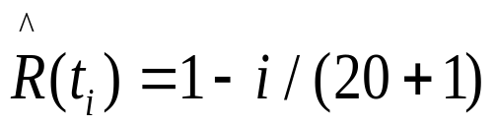
Singly Censored Data
Twenty units are placed on test for 72 hours with
the following failures times recorded: 1.5, 3.2,
11.7, 26.4, 39.1, 56.0, 61.3
TIME RELIABILITY CUM PROB (CDF)
0 1 0
1.5 .952381 4.761904E-02
3.2 .9047619 9.523809E-02
11.7 .8571429 .1428571
26.4 .8095238 .1904762
39.1 .7619048 .2380952
56 .7142857 .2857143
61.3 .6666667 .3333333
Cannot compute a mean or variance
Chapter 12
Notes:
For ungrouped incomplete failure data that is singly censored on the right, the empirical reliability function can be estimated exactly like it is for complete data. However, the function is truncated at the time of the last failure since there is no information available beyond that time. Since the data is incomplete, it is not possible to estimate the MTTF or the variance.

Slide 3
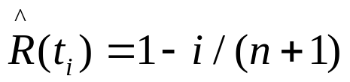
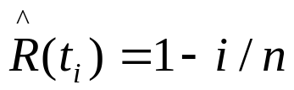
Ungrouped Censored Data
A sample consists of a set of ordered failure times
plus censored times:
t₁, t₂, t₃⁺, … t_{i}, t_{i+1}⁺, ..., t_{n}
Method complete data
Product Limit Estimator
Kaplan-Meier
Rank adjustment
Chapter 12
Notes:
For multiply censored data, a different approach is needed. Three different estimation techniques will be described. Notation t is a failure time and t⁺ is a censored time. if complete data is available the product limit estimator is equivalent to using the mean plotting position while the Kaplan-Meier estimator is equivalent to using the i/n plotting position.

Slide 4
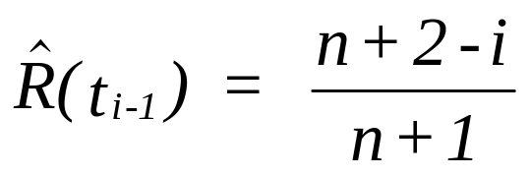
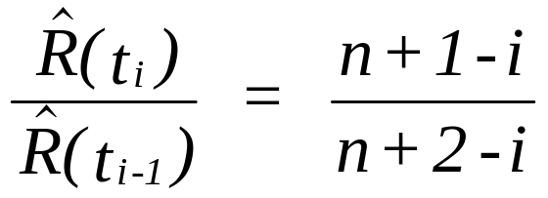
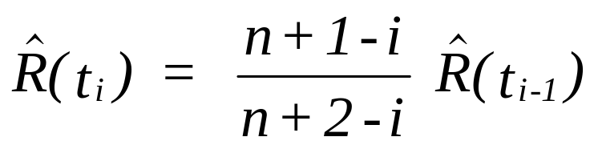
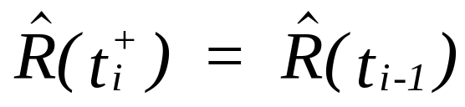
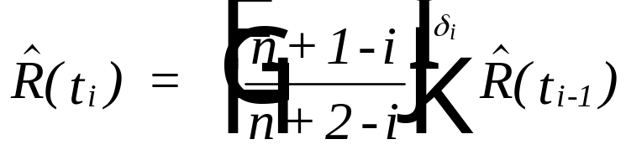
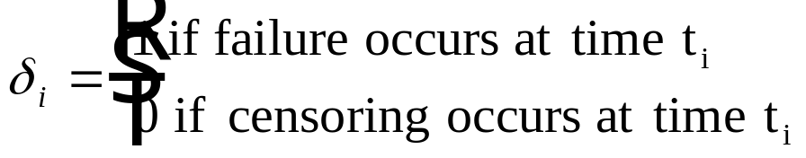
Product Limit Estimator (PLE)
and
then
however
where
Chapter 12
Notes:
Shown is the derivation of the product limit estimator. Analyze each step in order to understand the basis for this estimator.

Slide 5
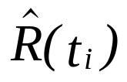
Example 12.6
The following failure and censor times (in operating hours) were recorded on 10 turbine vanes. Censoring was a result of failure modes other than fatigue or wear out. Determine an empirical reliability curve. 150, 340+, 560, 800, 1130+, 1720, 2470+, 4210+, 5230, 6890
i t_{i} (11-i)/(12-i)
1 150 10/11 R(150) = 10/11x1 = .9090
2 340+ 9/10
3 560 8/9 R(560) = 8/9 x.9090= .8081
4 800 7/8 R(800) = 7/8 x.8081= .7071
5 1130+ 6/7
6 1720 5/6 R(1720) = 5/6 x.7071=.5892
7 2470+ 4/5
8 4210+ 3/4
9 5230 2/3 R(5230)= 2/3 x.5892= .3928
10 6890 1/2 R(6890)= 1/2 x..3928=.1964
Chapter 12
Notes:
An example using the product limit estimator. Try exercising the course software with the same example.

Slide 6
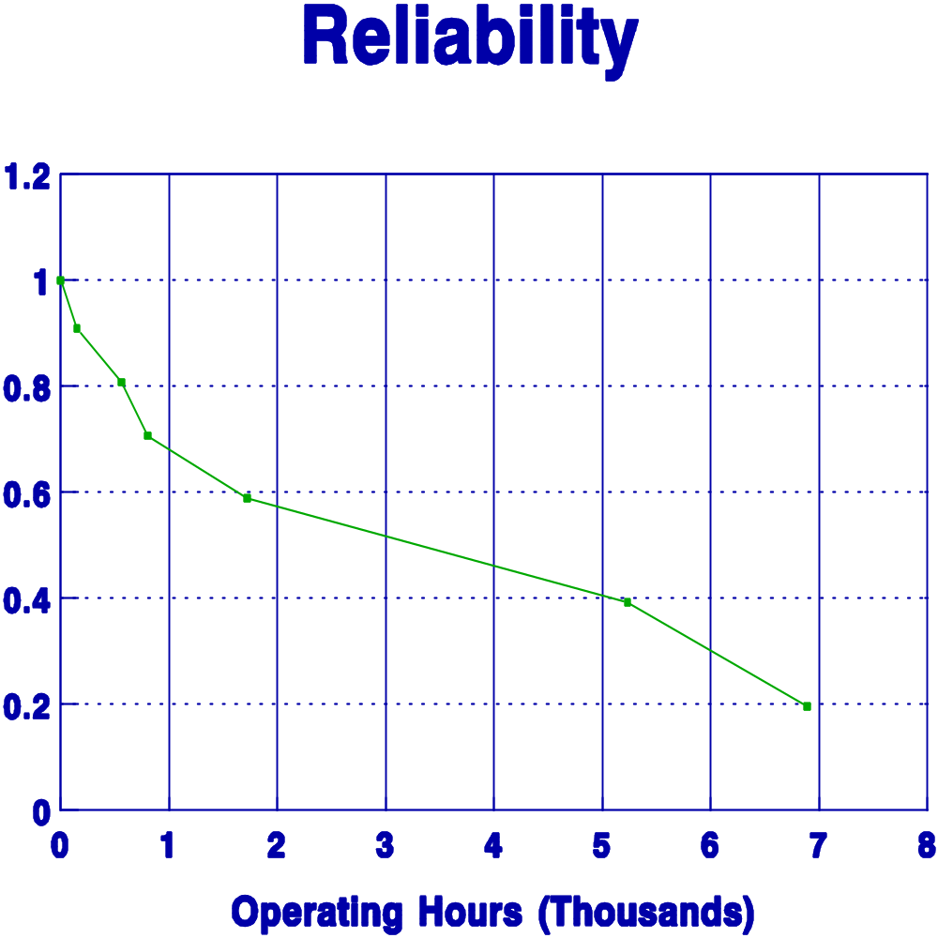
Example 12.6
Chapter 12
Notes:
A plot based upon the product limit estimator.

Slide 7
Kaplan-Meier PLE
Begin with with R(t₀=0) = 1
R( t_{i} ) = R( t_{i} | t_{i-1} ) R( t_{i-1} )
= (n_{i-1} - 1) / n_{i-1} R( t_{i-1} )
= (1 - 1 / n_{i-1} ) R( t_{i-1} )
Chapter 12
Animated
Notes:
The derivation of the Kaplan-Meier estimator is shown. The reliability estimates are developed recursively. The reliability at (failure time) t_{i} is equal to the reliability at time t_{i-1} times the conditional probability of surviving to time t_{i}.

Slide 8
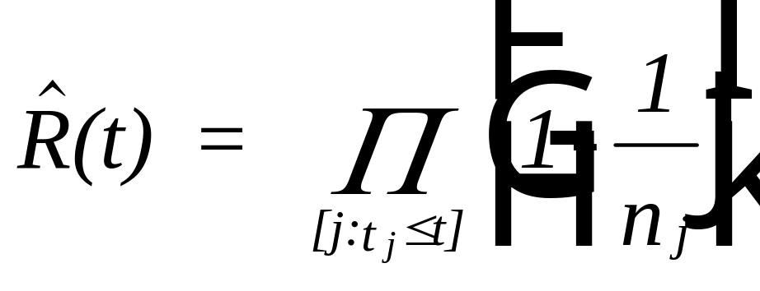
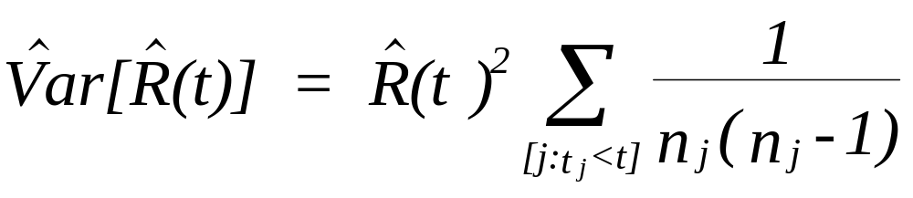
Kaplan-Meier PLE
For 0 ≤ t < t₁ , R(t) = 1
Chapter 12
Notes:
The estimated reliability is the product of the terms 1 – 1/n_{j}. An estimate for the variance of the estimated reliability can also be found. This provides a measure of the variability of the estimate.

Slide 9
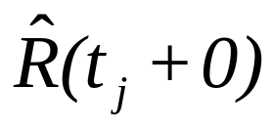
Example 12.7
j t_{j} n_{j} 1-1/n_{j} Std Dev
1 150 10 9/10 R(150) = 9/10 x 1.0 = .90 .095
2 340+
3 560 8 7/8 R(560) = 7/8 x.90 = .7875 .134
4 800 7 6/7 R(800) = 6/7 x.7875= .675 .155
5 1130+
6 1720 5 4/5 R(1720) = 4/5 x.675 =.54 .173
7 2470+
8 4210+
9 5230 2 1/2 R(5230)= 1/2 x.54= .27 .210
10 6890 1 0 R(6890)= 0 x .3928= 0
Chapter 12
Notes:
An example using the Kaplan-Meier estimator.

Slide 10
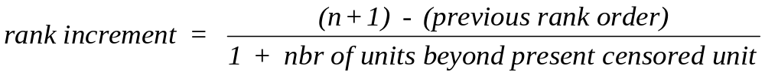
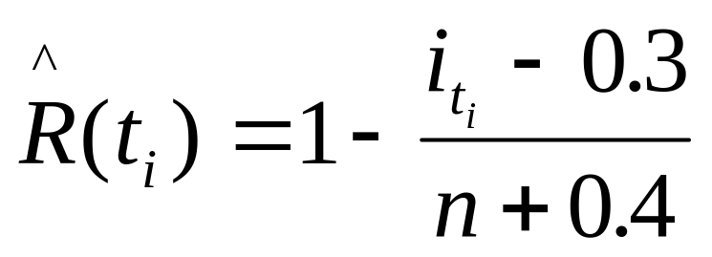
Rank Adjustment Method
i_{ti} = i_{ti-1} + rank increment
Chapter 12
Notes:
A third approach to estimating the reliability function is the rank adjustment method. If there were no censored units, then the failure times would be ranked in ascending order of their failure times. However, if a censored time occurs, then an adjustment is made to account for the fact that the censored unit may have failed either before or after the next failure. Therefore the next failure (and all subsequent failures) have their rank orders adjusted to account for this uncertainty. The adjustment is based upon the rank increment as defined above. The adjusted rank is then used in determining the plotting position. The approximation to the median plotting is shown here.

Slide 11
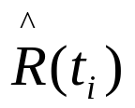
Example 12.8
i t_{i} Increment Adj Rank (i)
1 150 1 .933
2 340+
3 560 (11-1)/(1+8) = 1.111 1+1.111 = 2.111 .826
4 800 2.111 + 1.111 = 3.222 .719
5 1130+
6 1720 (11-3.222)/(1+5) = 1.2963 3.222+1.2963 = 4.518 .594
7 2470+
8 4210+
9 5230 (11-4.518)/(1+2)= 2.16 4.518 + 2.160 = 6.679 .387
10 6890 6.679 + 2.160 = 8.839 .179
Chapter 12
Notes:
Shown is an example of the rank adjustment method.

Slide 12
Multiply censored comparison
Failure time PLE Kaplan Rank Adj
-Meier
150 .909 .90 .933
340+
560 .808 .788 .826
800 .707 .675 .719
1130+
1720 .589 .54 .594
2470+
4210+
5230 .393 .27 .387
6890 .196 0 .179
Chapter 12
Notes:
This is a comparison of the three methods for estimating the reliability function with multiply censored data.

Slide 13
Example 12.9 - multiply censoring
Failed Failure
Unit Component Time
#1 C1 352 hrs
#2 C2 521
#3 C1 177
#4 C1 67
#5 C3 411
#6 C2 125
#7 C1 139
#8 C1 587
#9 C3 211
#10 C1 379
3 components
in series
Chapter 12
Notes:
An important example of multiply censored data occurs when there are several failure modes (or components as shown here). If the reliability of one of the failure modes (components) is to be estimated, the failure times of the other failure modes (components) become censored times.

Slide 14
Example 12.9 - multiply censoring
Component 1
TIME FACTOR RELIABILITY
1 67 .9090909 .9090909
2 125 + 1
3 139 .8888889 .8080809
4 177 .875 .7070708
5 211 + 1
6 352 .8333333 .5892256
7 379 .8 .4713805
8 411 + 1
9 521 + 1
10 587 .5 .2356903
Chapter 12
Notes:
Using the product limit estimator, an empirical reliabilities are determined for component 1. The failure times fpor components 2 and 3 are treated as censored times. Using the same data, find the empirical reliabilities of component 2. Would a larger sample size be useful?

Slide 15
Chapter 12
Data Collection and Empirical Methods
  Ungrouped Censored Data
  Grouped Censored Data
  Static Life Estimation
  Non-parametric confidence intervals
Notes:
The focus changes now from one of developing and analyzing reliability and maintainability models to the analysis of failure and repair data. We begin by establishing some empirical reliabilities generated directly from failure data that has been collected. Later, we will fit theoretical failure distributions to this same failure data.

Slide 16
Grouped Censored Data Life Tables
Assume that the failure and censor times have been
grouped into k+1 intervals of the form [t_{i-1}, t_{i}),
for i = 1, 2, ..., k+1; where t₀ = 0 and t_{k+1} = ∞.
Chapter 12
Notes:
For grouped multiply censored data, life tables are constructed. Life tables are commonly used in medical research to estimate survivor probabilities for various illnesses. The number of surviving patients resulting from some medical or surgical treatment is tracked often annually. Censoring takes place when a patient dies from a cause unrelated to the illness being treated or leaves the study group for some reason.

Slide 17
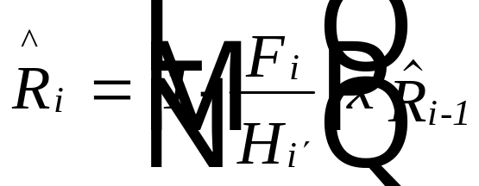
Grouped Censored Data Life Tables
F_{i} = the number of failures in the ith interval
C_{i} = the number of censors in the ith interval
H_{i} = the number at risk at time t_{i-1}
where H_{i} = H_{i-1} - F_{i-1} - C_{i-1} and H'_{i} = H_{i} - C_{i}/2
Then F_{i}/H'_{i} = conditional probability of a failure in
the ith interval given survival to time t_{i-1}
and p_{i} = 1-F_{i}/H'_{i} = conditional probability of
surviving the ith interval given survival to time t_{i-1}
Chapter 12
Notes:
The data needed to construct a life table are the number of failures (F) and censors (C) in each time interval. The empirical reliabilities are developed recursively by multiplying the probability (reliability) of surviving to the i-1 interval times the conditional probability of surviving to the next interval given you have survived to the i-1 interval.

Slide 18
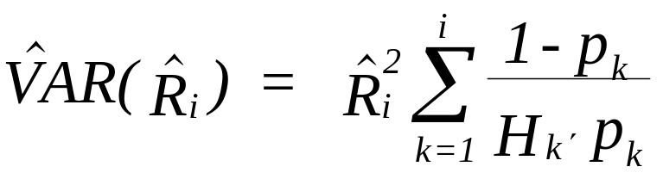
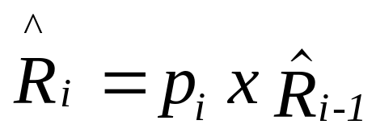
Grouped Censored Data Life Tables
Number Number At Adj at Prob
Interval Failures Censored Risk Risk Survival Reliability
[t_{i-1}, t_{i}) F_{i} C_{i} H_{i} H'_{i} p_{i} R_{i}
reliability
data
H'_{i} = H_{i} - C_{i}/2
H_{i} = H_{i-1} - F_{i-1} - C_{i-1}
p_{i} = 1-F_{i}/H'_{i}
Chapter 12
Notes:
The columns of a life table are constructed as shown here.

Slide 19
Example 12.10
Construct a life table for the engine of a fleet of 200 single
engine aircraft having the following annual failures and
removals (censors).
Year Failures Removals
1981 5 0
1982 10 1
1983 12 5
1984 8 2
1985 10 0
1986 15 6
1987 9 3
1988 8 1
1989 4 0
1990 3 1
Chapter 12
Notes:
This is the input data for constructing a life table.

Slide 20
Example 12.10
YEAR Fi Ci Hi H'i pi Ri Std Dev
1 5 0 200 200 .975 .975 .011
2 10 1 195 194.5 .949 .925 .019
3 12 5 184 181.5 .934 .864 .024
4 8 2 167 166 .952 .822 .027
5 10 0 157 157 .936 .770 .030
6 15 6 147 144 .896 .690 .033
7 9 3 126 124.5 .928 .640 .035
8 8 1 114 113.5 .930 .595 .036
9 4 0 105 105 .962 .572 .036
10 3 1 101 100.5 .970 .555 .036
Chapter 12
Notes:
Construct this same table using the course software. A life table can also be constructed using complete grouped data.

Slide 21
Chapter 12
Data Collection and Empirical Methods
  Ungrouped Censored Data
  Grouped Censored Data
  Static Life Estimation
  Non-parametric confidence intervals
Notes:
The focus changes now from one of developing and analyzing reliability and maintainability models to the analysis of failure and repair data. We begin by establishing some empirical reliabilities generated directly from failure data that has been collected. Later, we will fit theoretical failure distributions to this same failure data.

Slide 22
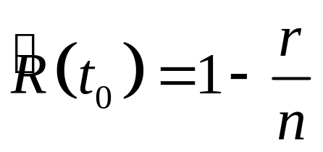
Static Life Estimation
n units at risk for a time t₀ with r failures observed
If an event of short duration is observed, t₀ may be omitted and the point reliability estimate is based simply on the number of failures r resulting from the application of n static loads
A point estimate for the reliability is given by
Chapter 12

Slide 23
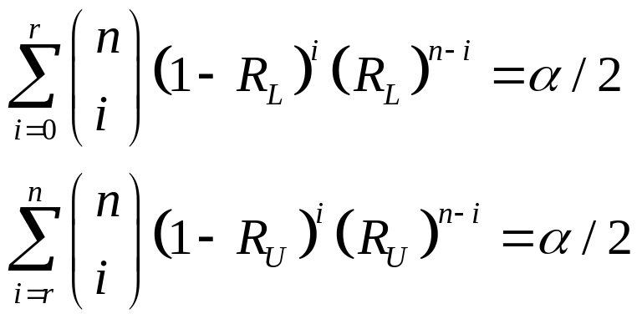
Static Life Estimation – interval estimation
From the binomial distribution:
Pr{R_{L} ≤ R(t₀) ≤ R_{U}} = 1 – α, and we are 100(1 - α) percent confident that that the population static reliability falls between R_{L} and R_{U}
Chapter 12

Slide 24
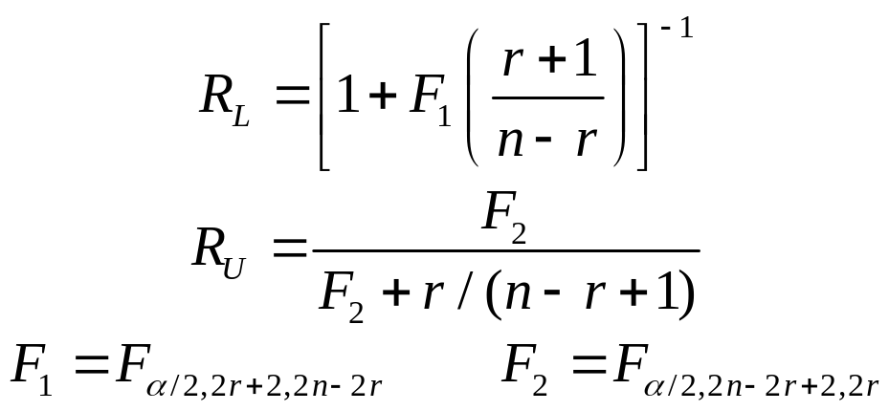

Static Life Estimation – interval estimation
From the relationship between the binomial and F distributions:
is a value from the F-distribution having n₁ and n₂ degrees of freedom and having an upper-tail probability of α/2.
Chapter 12

Slide 25
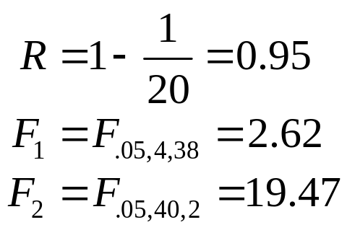
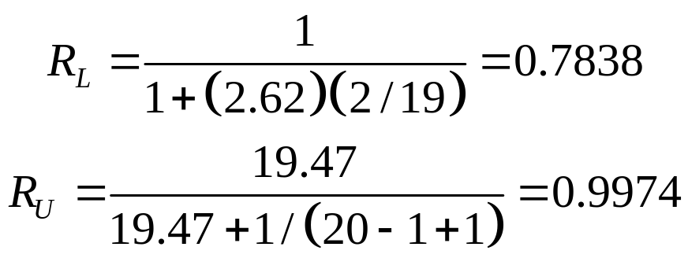
Example 12.12
It is desired to estimate the launch reliability of a booster rocket used to launch communication satellites into orbit. Twenty launches have been completed to date with one failure observed. Compute a 90 percent confidence interval for the rocket launch reliability.
Solution. With n = 20 and r = 1,
Chapter 12

Slide 26
Chapter 12
Data Collection and Empirical Methods
  Ungrouped Censored Data
  Grouped Censored Data
  Static Life Estimation
  Non-parametric confidence intervals
Notes:
The focus changes now from one of developing and analyzing reliability and maintainability models to the analysis of failure and repair data. We begin by establishing some empirical reliabilities generated directly from failure data that has been collected. Later, we will fit theoretical failure distributions to this same failure data.

Slide 27
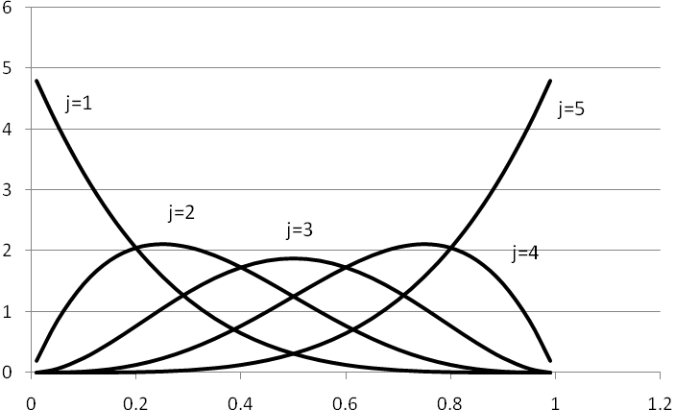
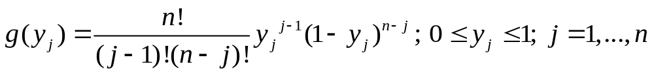
Nonparametric Confidence Intervals
Define Y_{j} to be a random variable, the fraction in a sample of size n that fail prior to t_{j}.
Chapter 12

Slide 28
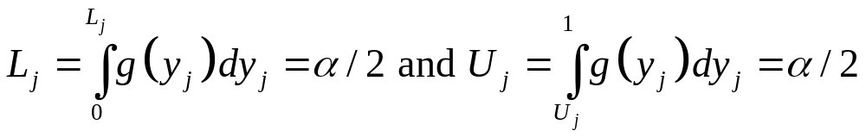
Nonparametric Confidence Intervals
If a 100(1-α) percent confidence interval is desired for the fraction failing prior to the j^{th} failure time, then define L_{j} and U_{j} so that
Therefore Pr{ L_{j} ≤ Y_{j} ≤ U_{j} } = 1 - α.
Chapter 12

Slide 29
Example 12.13
For a sample size of 5 and α = .20, Lj, U_{j}, and the median of Y_{j} are
j | L_{j} | median | U_{j}
1 | 0.0209 | 0.1294 | 0.3690
2 | 0.1122 | 0.3138 | 0.5839
3 | 0.2466 | 0.5000 | 0.7534
4 | 0.4161 | 0.6862 | 0.8878
5 | 0.6310 | 0.8706 | 0.9791
Chapter 12

Slide 30
Example 12.14
Based upon the failure times given in Example 12.2 with n = 10 and α = .10, the following plotting positions are computed:
failure times | 5% rank | Median | 95% rank
0 | 0 | 0 | 0
15.4 | 0.0051 | 0.0670 | 0.2589
18.9 | 0.0368 | 0.1623 | 0.3942
20.1 | 0.0873 | 0.2586 | 0.5069
24.5 | 0.1500 | 0.3551 | 0.6066
29.3 | 0.2224 | 0.4517 | 0.6965
33.9 | 0.3035 | 0.5483 | 0.7776
48.2 | 0.3934 | 0.6449 | 0.8500
54.7 | 0.4931 | 0.7414 | 0.9127
72 | 0.6058 | 0.8377 | 0.9632
86.1 | 0.7411 | 0.9330 | 0.9949
Chapter 12

Slide 31
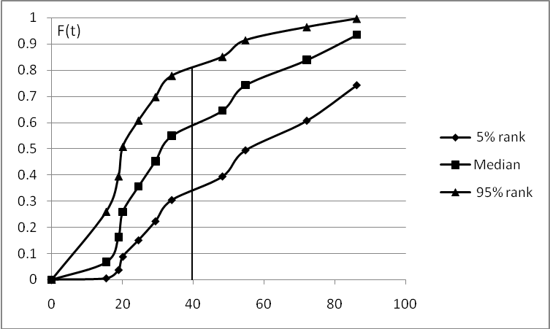
Example 12.14
Chapter 12

Slide 32
Chapter 12 – Data Collection and Empirical Methods
  Ungrouped Complete Data
  Grouped Complete Data
  Ungrouped Censored Data
  Grouped Censored Data
  Static Life Estimation
  Non-parametric confidence intervals
Notes:
The focus changes now from one of developing and analyzing reliability and maintainability models to the analysis of failure and repair data. We begin by establishing some empirical reliabilities generated directly from failure data that has been collected. Later, we will fit theoretical failure distributions to this same failure data.

